Slide 1
COE GUI overview
GUI of COE were developed using MFC and programmers need to install MS VC++ 2017 because COE also used ribbon which is delivered in VC 2017.

Slide 2
How to add a button on ribbon bar
Ribbon category
Ribbon bar
Ribbon panel
Ribbon button
About how to add ribbon category, ribbon panel, ribbon button, please refer to the source code in RibbonBar::CreatePartLayoutCategory function, it’s easy to understand.

Slide 3
How to add a new dialog
As we discussed in “4 - Software Architecture of COE”, COE put all dialog resources into clResource module, so other modules will load dialog resource from this dll.
In this section, we still base on the sample project partInstanceCount in UICode solution which is under UICode\sampleCode folder to illustrate how to add your new dialogs.

Slide 4
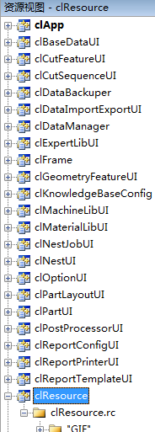
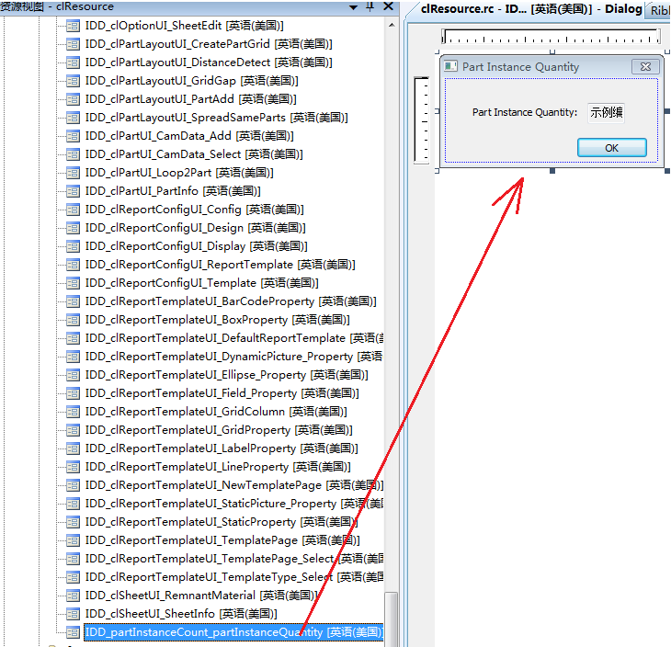
Step 1, open clResource project in VC resource view, than create a new dialog resource as the below figure.
create such a dialog resource
创建一个这样的对话框资源

Slide 5
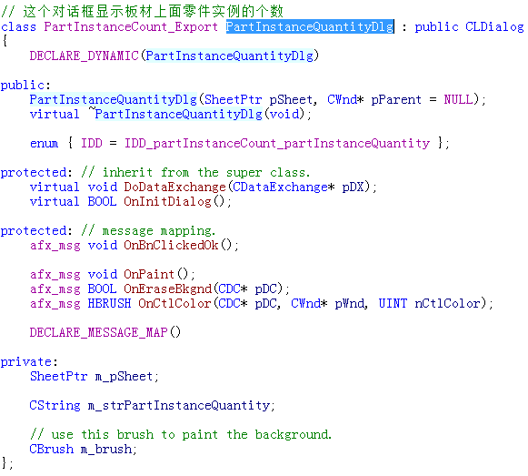
Step 2, open partInstanceCount project which is under UICode\sampleCode , add the implementation source code for the new dialog, please refer to PartInstanceQuantityDlg class.

